Slide 1

Vector Auto Regression
SREE KAVYA DURBAKA
E22033

Slide 2
What is VAR
Vector Autoregression (VAR) is a forecasting algorithm that can be used when two or more time series influence each other.
So far, we have studied univariate time series modelling techniques.
In this method, we model multiple time series as vectors. The predicted output again will be a vector.
Autoregression is the same as the autoregression we have studied before.

Slide 3
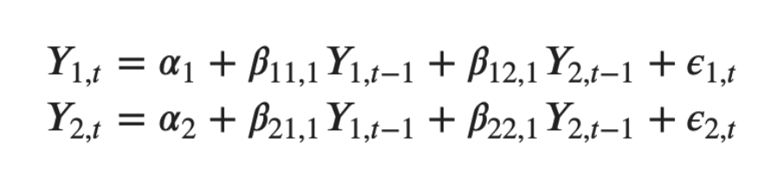
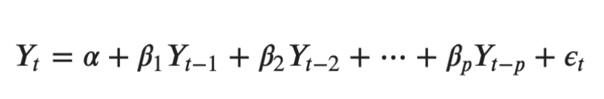
AR vs VAR model

Slide 4
Granger’s Causality
Granger causality is a way to investigate causality between two variables in a time series.
A variable X is causal to variable Y if X is the cause of Y or Y is the cause of X.
You aren’t testing a true cause-and-effect relationship; What you want to know is if a particular variable comes before another in the time series. In other words, if you find Granger causality in your data there isn’t a causal link in the true sense of the word.
We are just checking precedence!
The null hypothesis for the test is that lagged x-values do not explain the variation in y. In other words, it assumes that x(t) doesn’t Granger cause y(t).

Slide 5
About the test
Make sure your time series is stationary before proceeding.
The null hypothesis is that the coefficients of past values in the regression equation are zero
Reference: Granger Causality: Definition, Running the Test - Statistics How To

Slide 6
Cointegration Test
A cointegration test is used to establish if there is a correlation between several time series in the long term.
It helps to establish the presence of a statistically significant connection between two or more time series.
The Johansen test is used to test cointegrating relationships between several non-stationary time series data
.
Test Stat > C(95%) => Signif

Slide 7
Johansen test
If the test statistic is > critical value at say, 95% then we accept the null.
The Null hypothesis: The relationship is significant
Four 'variables' xi are co-integrated if one can find a linear combination of the four variables that are integrated of order zero.

Slide 8
Implementing VAR model
Check for stationarity of all the series.
Form A-D test.
If at least one series is not stationary, Perform differencing.

Slide 9
Selecting the order of the model
To select the right order of the VAR model, we iteratively fit increasing orders of the VAR model and pick the order that gives a model with the least AIC.
An alternate method to choose the order(p) of the VAR models is to use the model.select_order(maxlags) method.
The selected order(p) is the order that gives the lowest ‘AIC’, ‘BIC’, ‘FPE’ and ‘HQIC’ scores.

Slide 10
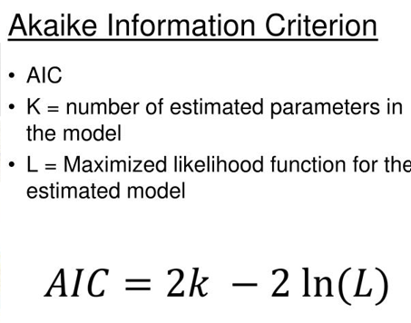
AIC refresher
Akaike Information Criterion
The Akaike information criterion ( AIC) is an estimator of out-of-sample prediction error and thereby relative quality of statistical models for a given set of data. Given a collection of models for the data, AIC estimates the quality of each model, relative to each of the other models.

Slide 11
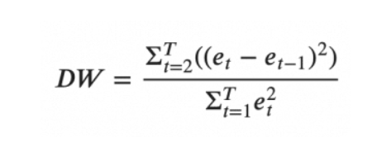
Serial correlation in errors
A common way of checking for serial correlation of errors can be measured using Durbin Watson’s Statistic.
The value of this statistic can vary between 0 and 4. The closer it is to the value 2, the more there is no significant serial correlation. The closer to 0, there is a positive serial correlation, and the closer it is to 4 implies a negative serial correlation.
# If there is no multicollinearity, we can proceed with the model!

Slide 12
Forecasting
In order to forecast, the VAR model expects up to the lag order number of observations from the past data.
This is because, the terms in the VAR model are essentially the lags of the various time series in the dataset, so you need to provide it as many of the previous values as indicated by the lag order used by the model.

Slide 13
Steps after forecast
De-difference the data as many times you had differenced the original input data.
Forecast vs Actuals plot
Evaluating the Forecasts

Slide 14
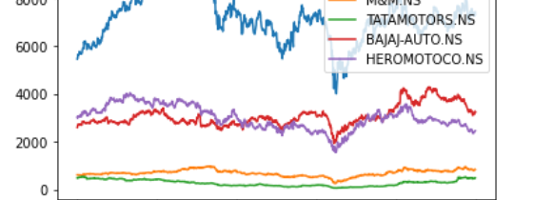
Thank You!
References: Vector Autoregression (VAR) - Comprehensive Guide with Examples in Python - Machine Learning Plus

